Slide 1

EMAIL SPAM DETECTION
STAYING SAFE ONLINE
2410030033 – T.Roopasri
2410030233 – CR.Pranavi
2410030248 – Swathi
2410030245 – Vishnuchethana

Slide 2

INTRODUCTION
Email is a popular way to send and receive messages. But sometimes, people get spam emails. These are unwanted messages that may be harmful or fake. They can try to steal personal information or damage your computer.
An Email Spam Detector is a tool that helps find spam emails. It keeps your inbox clean and safe. Today, we use smart computer programs (Python and Machine learning) to catch spam because spammers keep changing their tricks.
Your paragraph text

Slide 3


Problem Statement & Objective
Problem:
Increasing email spam attacks worldwide.
Limited research on multilingual and emotion-based spam detection.
Objective:
Develop a robust email spam detector using ML algorithms.
Improve accuracy with preprocessing and feature extraction techniques.

Slide 4

LITERATURE SURVEY
Year | Title | Techniques | Accuracy | Dataset | Limitations
2023 | Arabic Email Spam Detection | SVM, TF-IDF | 98-99% | Kaggle Arabic Emails | Language-specific
2022 | Intelligent Spam Detection | Random Forest, Naïve Bayes | 98.45% | English Spam Dataset | High computational cost
2021 | Almeida and José María Gómez Hidalgo at the University | LSTM, NLP, Naive Bayes, Decision Trees | 97% | Mixed Dataset | Limited dataset size
2020 | SMS Spam Filtering | Logistic Regression | 96% | Indian SMS Dataset | Poor multilingual support
2020 | Email Filterations | Decision Tree | 94% | Public Spam Emails | Overfitting issues

Slide 5




🛠️ TOOLS USED – KEY POINTS
•Kaggle (Dataset)
•Python(Programming Language)
•JupyterNotebook / VS Editor
•Pandas (Data Handling)
•HTML / CSS (Frontend)

Slide 6
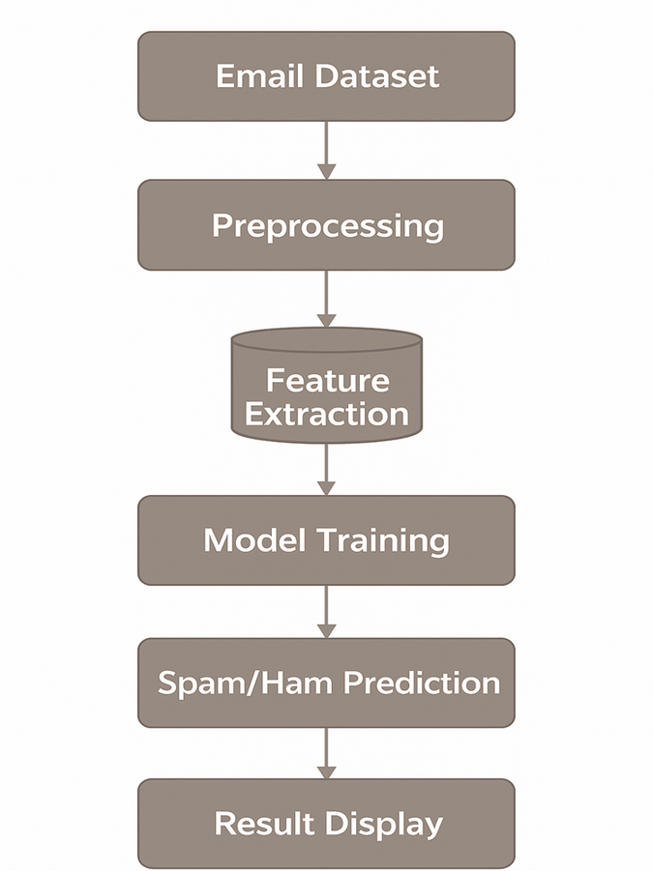
FLOWCHART

Slide 7

DATASET ANALYSIS SUMMARY
1.Number of Records: 5,572
2. Number of Features:
• label → category: ham or spam
• message → text of the email/SMS
3. Class Distribution:
• Ham (not spam): 4,825 (≈ 86%)
• Spam: 747 (≈ 14%)
4.Balanced or Not: Not balanced → dataset is skewed toward ham messages.
5.Source:
Created by Tiago A. Almeida and José María Gómez Hidalgo at the University of São Paulo, 2021.
•Naive Bayes → ~97.5% accuracy
•Support Vector Machines (SVM) → ~96.7% accuracy
•Decision Trees → ~95% accuracy

Slide 8


Preprocessing of DATA
1.Load
the
dataset
2.Handle missing
values
3.Remove
duplicates
5.Encoding categorical values
4.Data type
conversion
6.Normalization
:
:

Slide 9
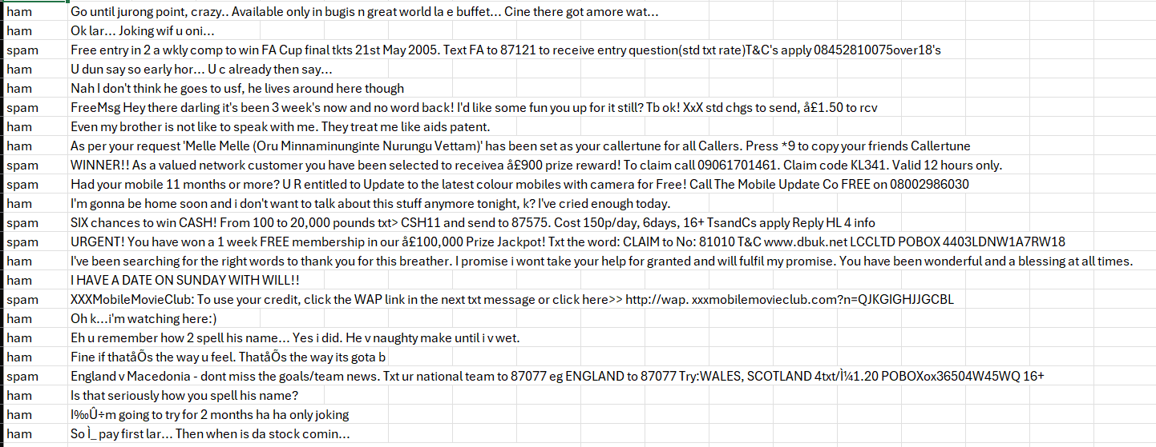
How the Dataset Was Prepared?
Removed unwanted parts
→ kept only label and message columns, and converted labels (ham = 0, spam = 1).
Cleaned the text
→ lowercase + removed punctuation for uniform messages.
Converted text into numbers using TF-IDF after splitting into training and test sets.
:
:

Slide 10
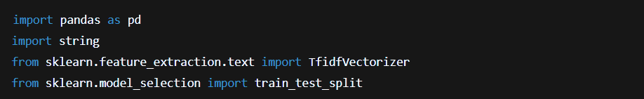
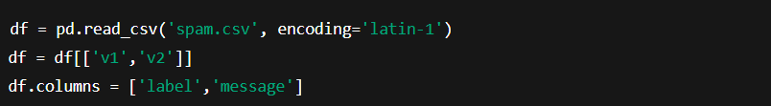
Imports
Load data & select columns
Handle missing values
Encode labels
:
:

Slide 11
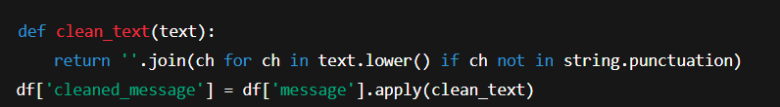
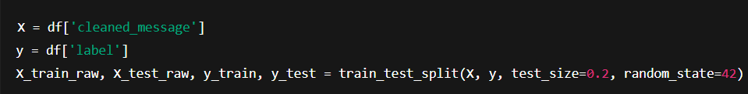
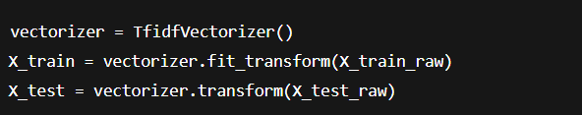
Clean text
Train / Test split
TF-IDF vectorization
Saving the Preprocessed CSV File
:
:

Slide 12
Ensuring Complete Data
label | Message | Cleaned message
0 | Go until jurong point, crazy.. Available only in bugis n great world... | go until jurong point crazy available only in bugis n great world
1 | Free entry in 2 a wkly comp to win FA Cup final tkts 21st May 2005... | free entry in 2 a wkly comp to win fa cup final tkts 21st may 2005
0 | Nah I don’t think he goes to usf, he lives around here though | nah i dont think he goes to usf he lives around here though
1 | WINNER!! As a valued network customer you have been selected... | winner as a valued network customer you have been selected
:
:

Slide 13
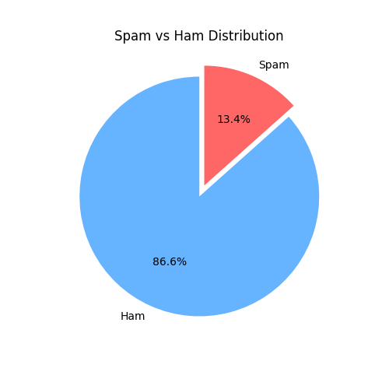
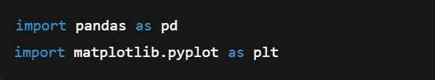
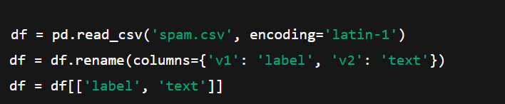
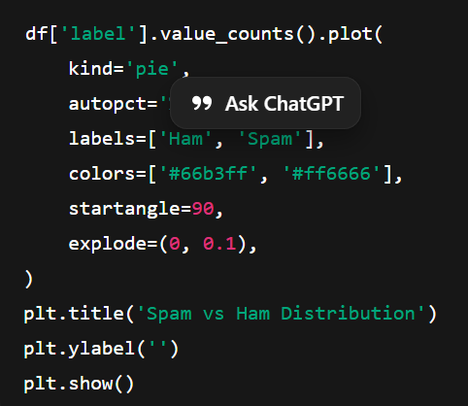


Pie Chart
Imports
Load Data & Select Columns
Plot Pie Chart
Encode Labels
Line Used for Pie Chart
:
:

Slide 14
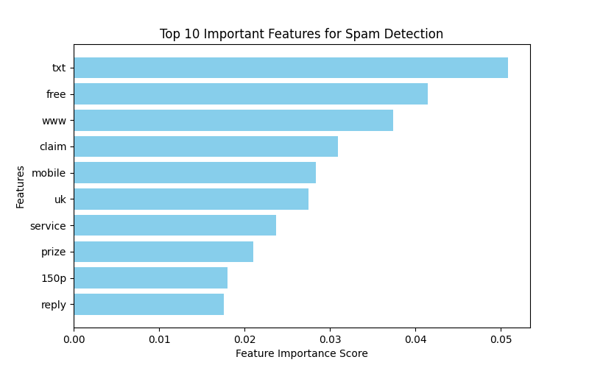

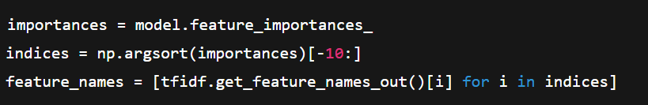
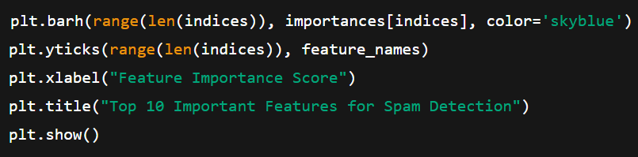

Horizontal Bar Chart
Imports
Feature Importances
Plot Bar Chart
Line Used for Horizontal Bar Chart
:
:

Slide 15
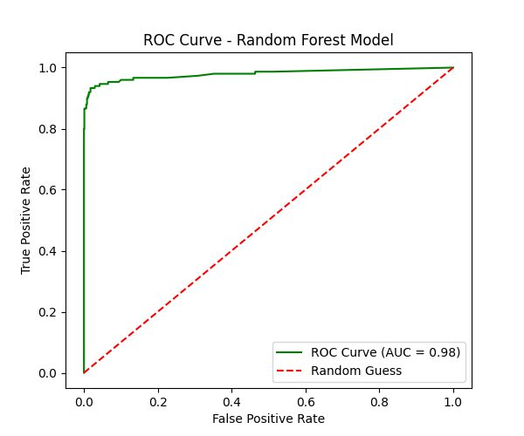
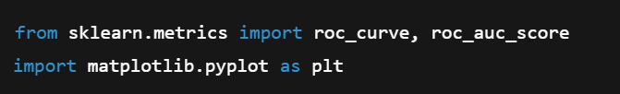


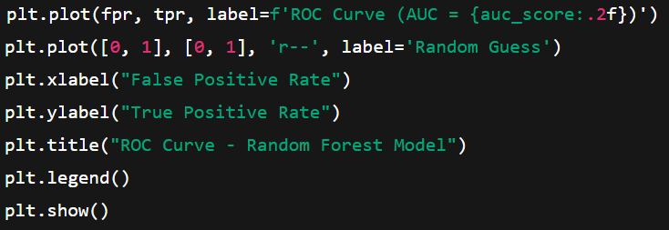

ROC Curve – Random Forest Model
Imports
Predict Probabilities
ROC Values
Plot ROC Curve
Main Line Used for This Graph
:
:

Slide 16
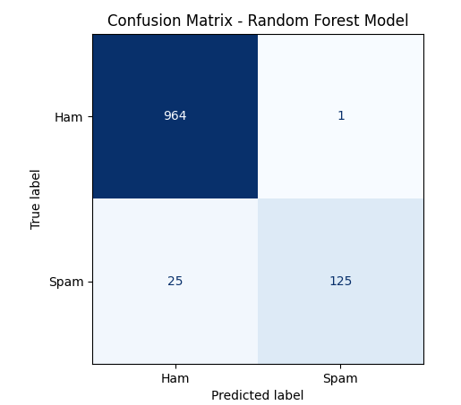



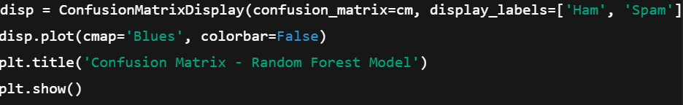

Confusion Matrix – Random Forest Model
Imports
Predictions for Test Data
Compute Confusion Matrix
Plot Confusion Matrix
Main Line Used
:
:

Slide 17

Conclusion – Data Preprocessing
  We started with raw text data containing labels and messages.
  Cleaned the data:
removed punctuation, converted text to lowercase & ensured
labels were numeric.
  Split the dataset into training and testing sets for proper model evaluation.
  Converted text into numerical vectors using TF-IDF, so the model can understand and learn patterns.
  After preprocessing, the dataset is ready for building a machine learning model to detect spam.

Slide 18

THANKYOU

